Slide 2
3D blade model updating by coupling HAWC2 and ABAQUS
Maria Luz Castilla Mena (s212601@dtu.dk)
Notes:
Hi, I am Maria and I am going to present my master thesis topic: Evolution of blade cracks with wind turbine simulation tolos (this is a provisional titile, it needs to be discussed)

Slide 3
INDEX
From last meeting
Progress of the project
For the next meeting

Slide 4
From last meeting
Plot moment results from HAWC2 and ABAQUS in same graph
Finish code workflow connecting HAWC2 and ABAQUS
Plot HAWC2 wind speed in MATLAB
Change HAWC2 wind speed input: Simulate wind gust: Make a wind profile. Implement turbulence
Show new results with my current workflow

Slide 5
Progress of the project

Slide 6

Progress of the project
Plot moment results from HAWC2 and ABAQUS in same graph
Finish code workflow connecting HAWC2 and ABAQUS
Plot HAWC2 wind speed in MATLAB
Change HAWC2 wind speed input: Simulate wind gust: Make a wind profile. Implement turbulence
Show new results with my current workflow

Slide 7
Challenges
Every time I try a new simulation, make the changes automatic using MATLAB
I.e. I had an .inp file with 10sec, modify .inp file automatic just to run the time I want defined by HAWC2
HAWC2 simulations take really long in my computer (1sec simulation = 1000sec = 15min)

Slide 8
Results

Slide 9
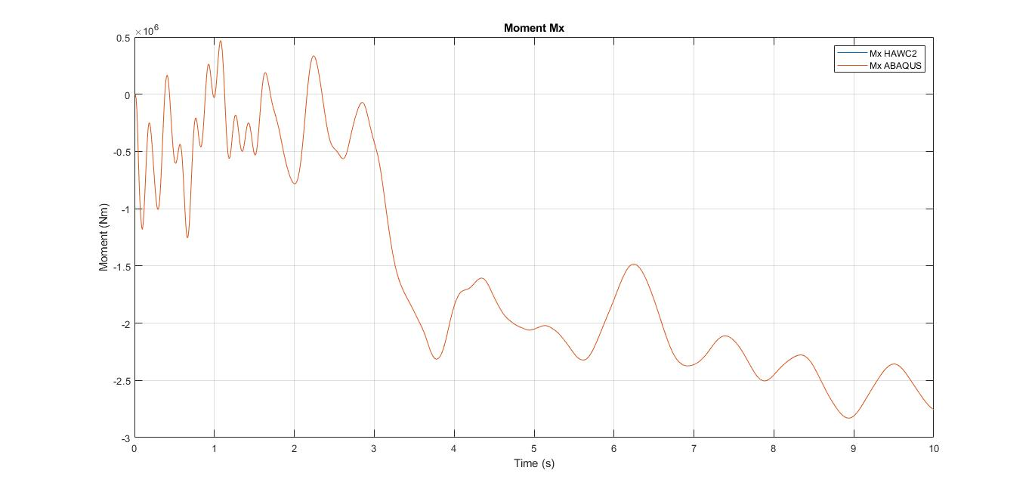
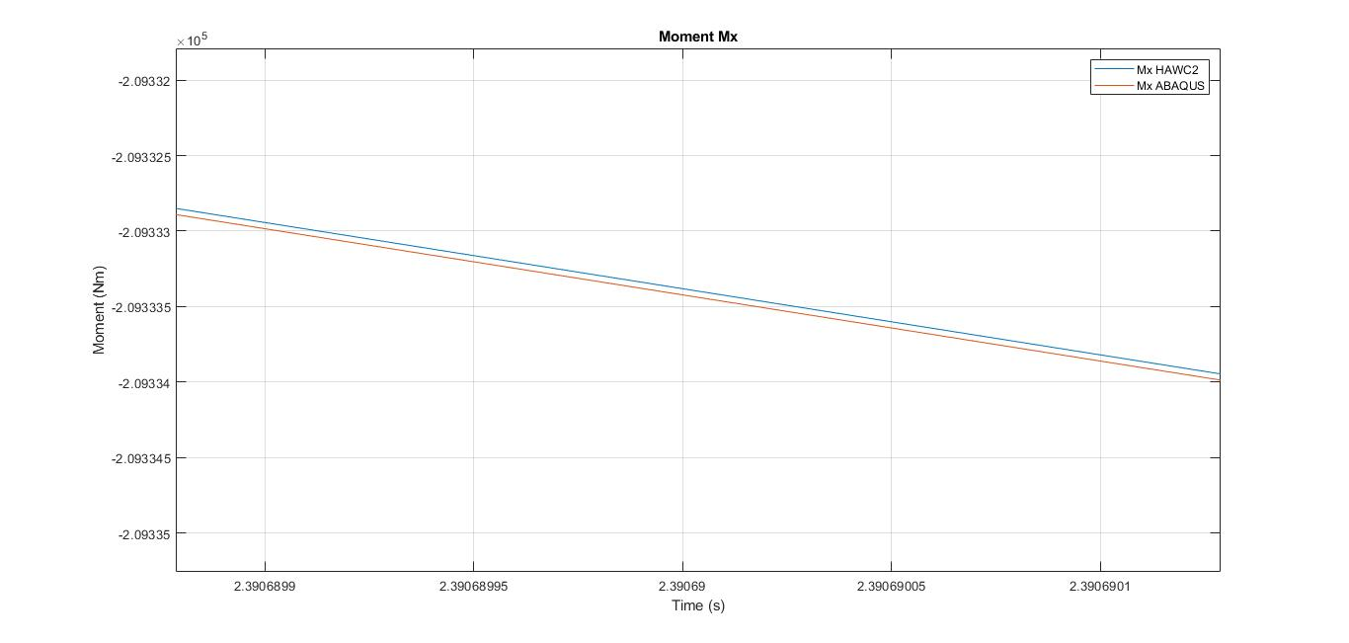
Moment HAWC2 and ABAQUS

Slide 10
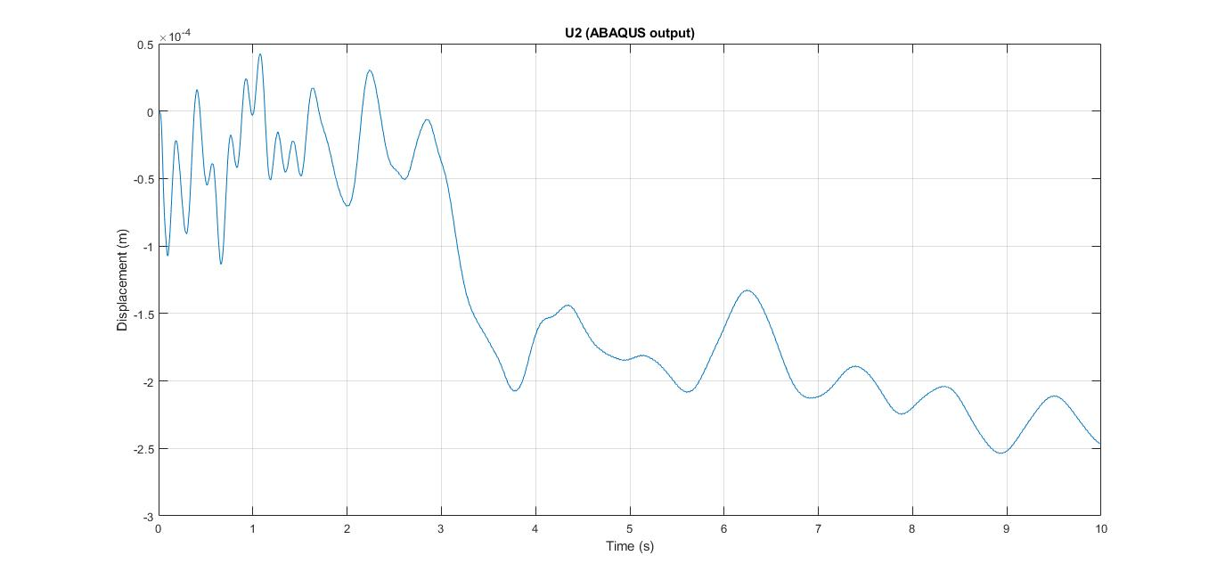
Displacement U2 free end

Slide 11
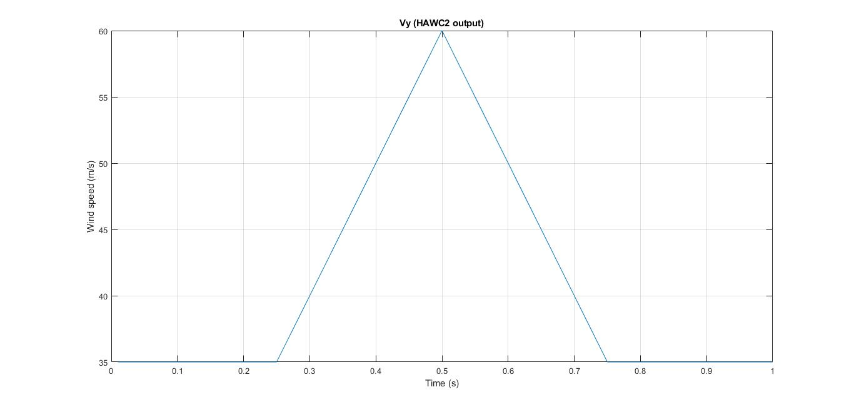
Wind gust: No turbulence

Slide 12
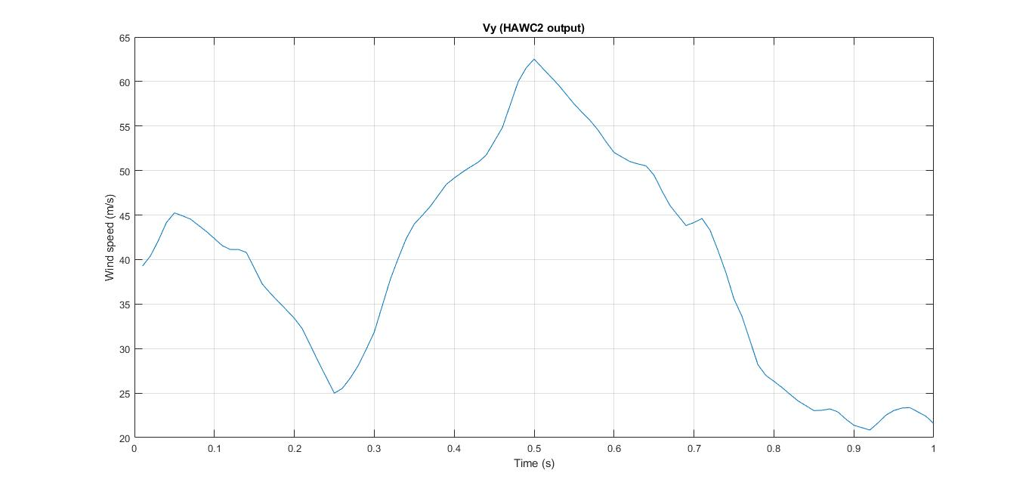
Wind gust: With turbulence and shear

Slide 13
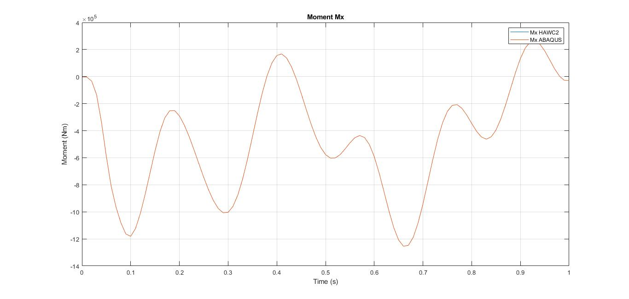
Moment Mx

Slide 14
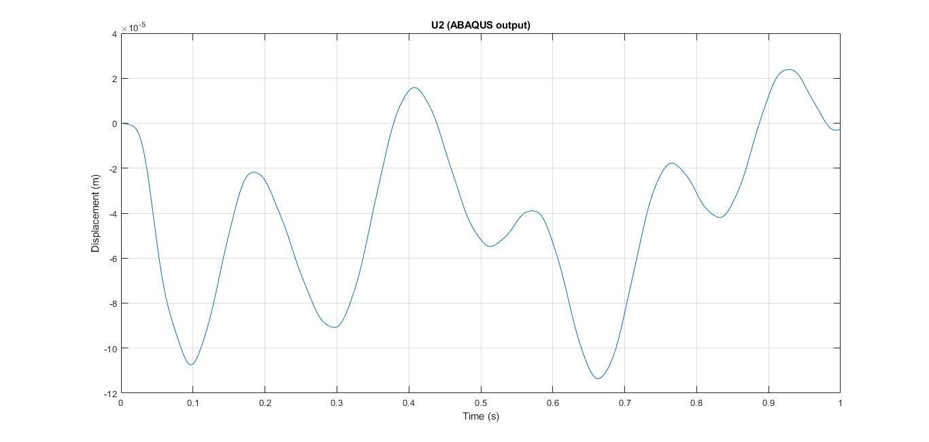
Displacement U2

Slide 15
Weird… change wind profile but I get same momento results… HAWC2?

Slide 16
For next meeting…

Slide 17
For the next meeting
Solve problem with HAWC2
More time efficient HAWC2 simulations
Realistic wind gust profile in a real simulation
Suggestions?

